Slide 1

Categories of algorithms
Sorting algorithms
Search algorithms
Graph algorithms & Greedy techniques
Path-finding (informed search) algorithms
Computational Geometry
Algorithms: Theory, Design and Implementation
Algorithms
F O U R T H E D I T I O N

Slide 2
Algorithms
Algorithms
PATH FINDING (INFORMED SEARCH) ALGORITHMS – PART II
A* search
Heuristics
Local search algorithms
Hill-climbing search
Genetic algorithms
F O U R T H E D I T I O N

Slide 3
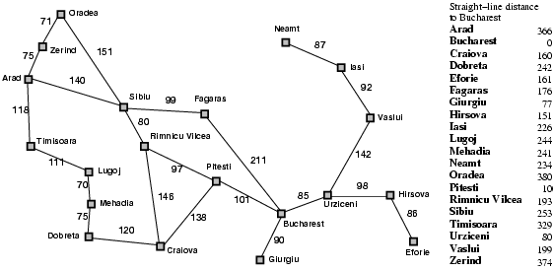
So far: Try A Heuristic
Heuristic: minimize h(n) = “Euclidean distance to destination”
Problem: not optimal (through Rimmici Viicea and Pitesti is shorter)

Slide 4
However, how do we create admissible heuristics
Relax the conditions of the problem
This will result in admissible heuristics!
Challenge: Find suitable heuristics…
Let us get back to the
travel sales(wo)man problem possible solution….
We may not even need heuristics if the problem definition permits….

Slide 5
Local search algorithms
In many optimization problems, the path to the goal is irrelevant; the goal state itself is the solution.
State space = set of "complete" configurations.
Find configuration satisfying constraints, e.g., n-queens.
In such cases, we can use local search algorithms.
keep a single "current" state, try to improve it.

Slide 6

Example: n-queens
Put n queens on an n × n board with no two queens on the same row, column, or diagonal

Slide 7
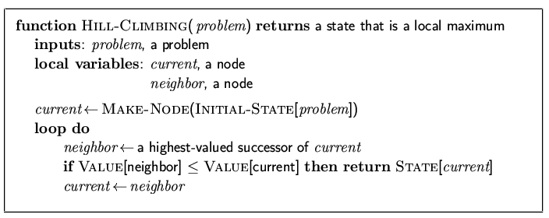
Hill-climbing search
"Like climbing Everest in thick fog with amnesia"

Slide 8
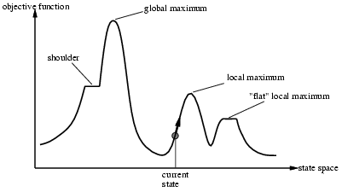
Hill-climbing search
Problem: depending on initial state, can get stuck in local maxima

Slide 9
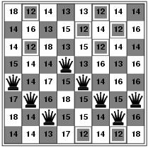
Hill-climbing search: 8-queens problem
h = number of pairs of queens that are attacking each other, either directly or indirectly
h = 17 for the above state

Slide 10
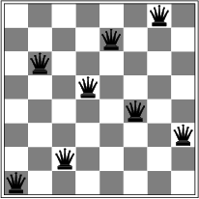
Hill-climbing search: 8-queens problem
A local minimum with h = 1

Slide 11
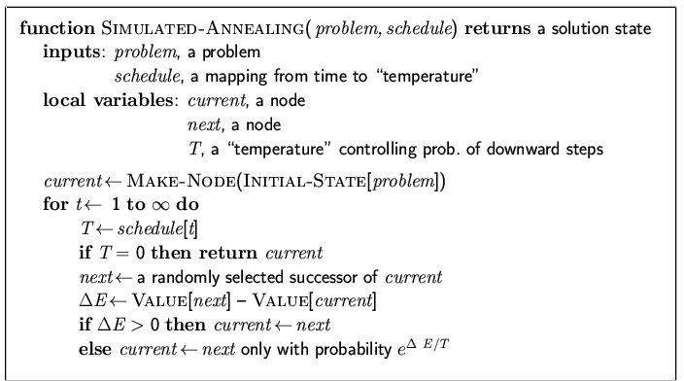
Simulated annealing search
Idea: escape local maxima by allowing some "bad" moves but gradually decrease their frequency

Slide 12
Properties of simulated annealing search
One can prove: If T decreases slowly enough, then simulated annealing search will find a global optimum with probability approaching 1
Widely used in VLSI layout, airline scheduling, etc.

Slide 13
Local beam search
Keep track of k states rather than just one
Start with k randomly generated states
At each iteration, all the successors of all k states are generated
If any one is a goal state, stop; else select the k best successors from the complete list and repeat.

Slide 14
Genetic algorithms
A successor state is generated by combining two parent states
Start with k randomly generated states (population)
A state is represented as a string over a finite alphabet (often a string of 0s and 1s)
Evaluation function (fitness function). Higher values for better states.
Produce the next generation of states by selection, crossover, and mutation

Slide 15
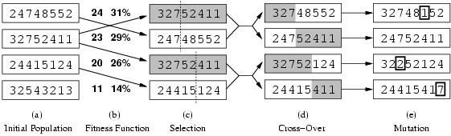
Genetic algorithms
Fitness function: number of non-attacking pairs of queens (min = 0, max = 8 × 7/2 = 28)
24/(24+23+20+11) = 31%
23/(24+23+20+11) = 29% etc

